Slide 1
Introduction to Bandit Problems in Reinforcement Learning
William Shipman | 2022

Slide 2
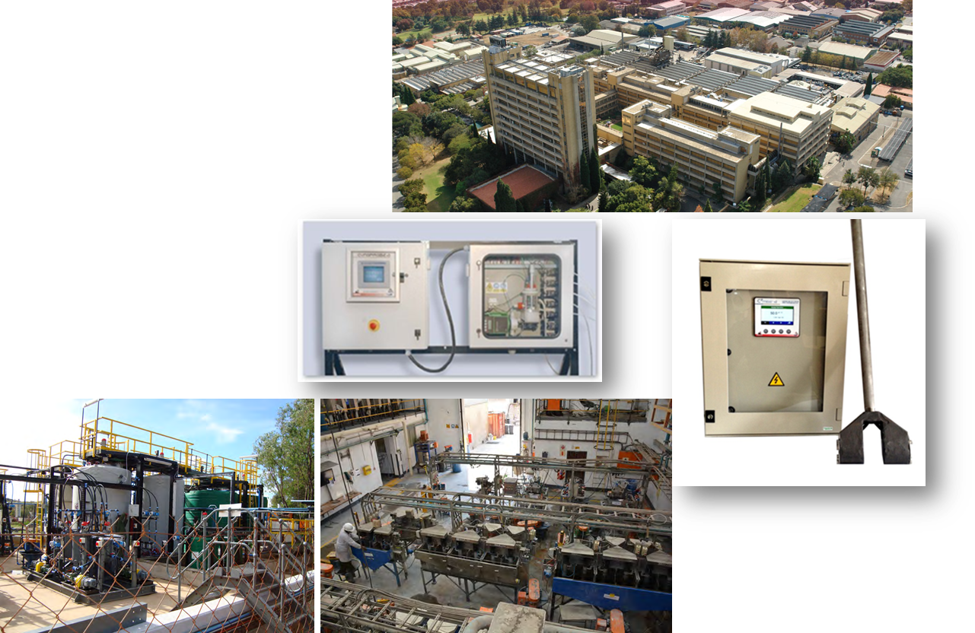
Who is Mintek?
South African Science Council in Johannesburg
Minerals processing and metallurgy research
Services and products for industry
Advanced process control (where I work)

Slide 3
Agenda
What is reinforcement learning (RL)?
What is the Markov Decision Process model?
Multi-armed bandits
Thompson Sampling
Continuous action spaces
Real-world examples
Useful resources

Slide 4
What is reinforcement learning?

Slide 5
"Reinforcement learning is learning what to do—how to map situations to actions—so as to maximize a numerical reward signal. The learner is not told which actions to take, but instead must discover which actions yield the most reward by trying them."
Sutton & Barto, 2008, "Reinforcement Learning: an introduction"

Slide 6
Basic components
An agent (me, my robot and I)
An environment (stock markets, metallurgical plants)
Some reward (beer, money, beer money)
Stochastic agent – some randomness to explore the world
Stochastic environment– noise, random disturbances
Maximize this over time

Slide 7
What is the Markov Decision Process Model

Slide 8
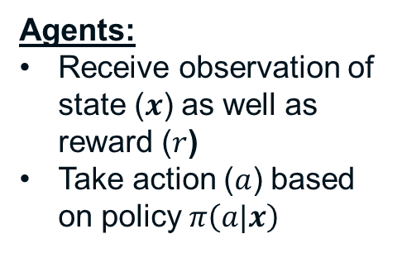
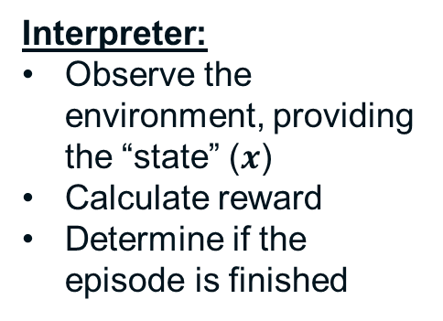
Markov Decision Processes in a nutshell
Environments:
Receive action, update internal state
Bandits
Grid world
Games (Atari games, chess, Go, StarCraft)
Differential equations (process control)
Interpreter:
Observe the environment, providing the “state” ($x$)
Calculate reward
Determine if the episode is finished
Agents:
Receive observation of state ($x$) as well as reward ($r$)
Take action ($a$) based on policy $π\left(a|x\right)$

Slide 9
Markov Decision Processes in a nutshell
Step 3: Reward calculation
Step 1 & 3: Observe
Step 2: Act

Slide 10
Bandit problems
Rewards depend only on the immediate action taken, not past actions.
Think steady-state response of a system => depends on action only.

Slide 11
Contextual bandit problems
Rewards depend on the immediate action taken and some context, e.g. user ID in an online advertising system.
Actions don’t affect the context, but the context can change arbitrarily.
Context

Slide 12
Multi-armed bandits

Slide 13
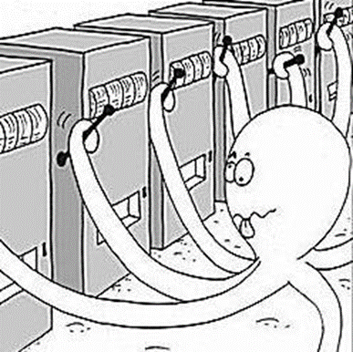
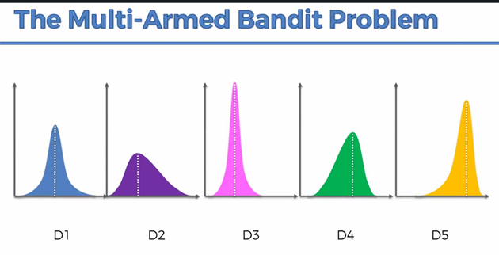
Bandits
Multi-armed bandit: take the best action from a finite set of actions, receive a reward, where the probability distribution of the reward depends on the action taken.
Goal: maximize expected reward
Continuum-armed bandit: infinitely many choices, actions are continuous variables

Slide 14
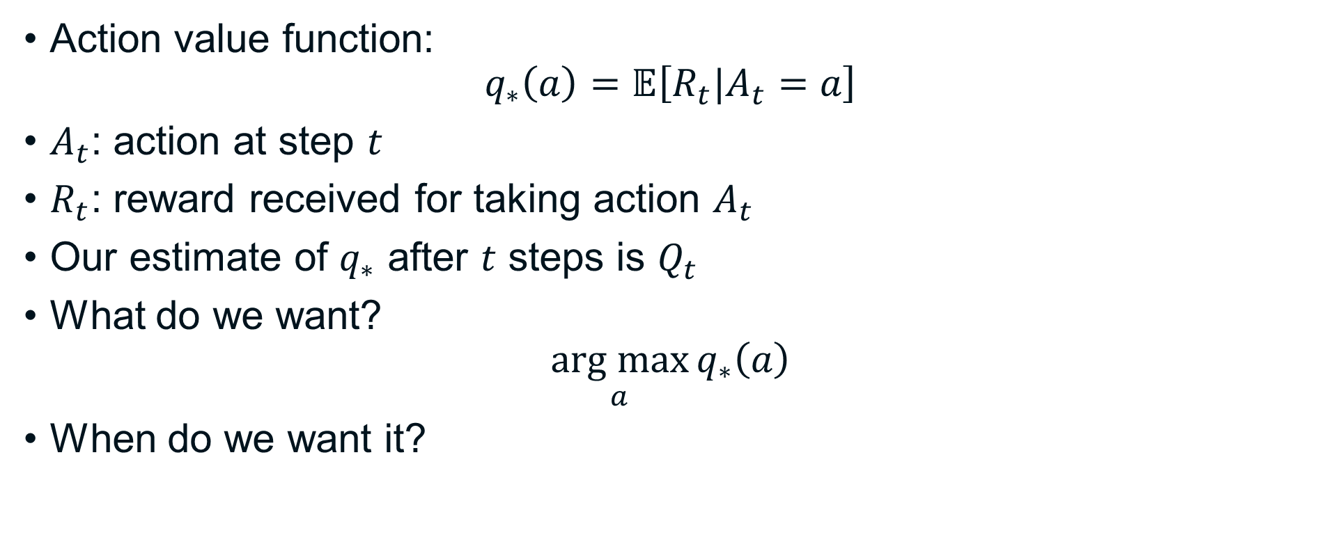
Some notation
Action value function:
$$q_{∗}\left(a\right)=𝔼\left[R_{t}|A_{t}=a\right]$$
$A_{t}$: action at step $t$
$R_{t}$: reward received for taking action $A_{t}$
Our estimate of $q_{∗}$ after $t$ steps is $Q_{t}$
What do we want?
$$\underset{a}{arg max}{q_{∗}\left(a\right)}$$
When do we want it?

Slide 15
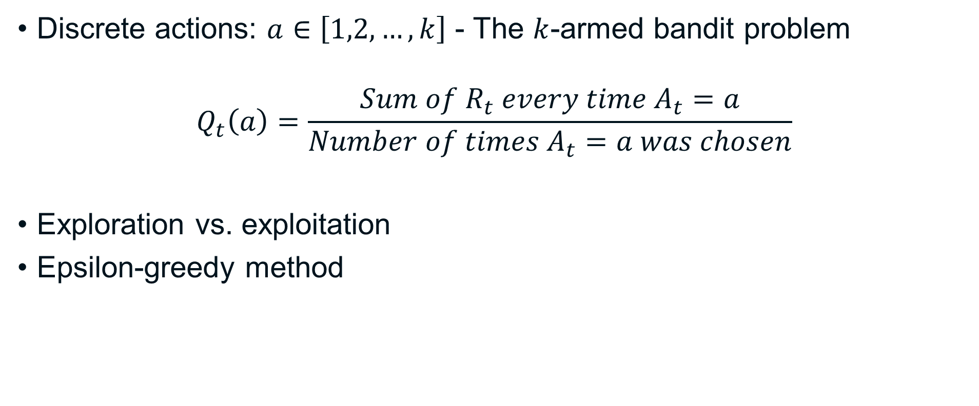
Start simple – tabular solution
Discrete actions: $a∈\left[1,2,…,k\right]$ - The $k$-armed bandit problem
$$Q_{t}\left(a\right)=\frac{Sum of R_{t} every time A_{t}=a}{Number of times A_{t}=a was chosen}$$
Exploration vs. exploitation
Epsilon-greedy method

Slide 16
So who uses bandits anyway?
Content recommendations online (advertising, news, products, videos, e.g. Netflix, Microsoft)
DeepMind
Product pricing
Clinical trials, e.g. finding the right dosage
Selecting drilling patterns for exploration in mining

Slide 17
Thompson Sampling

Slide 18
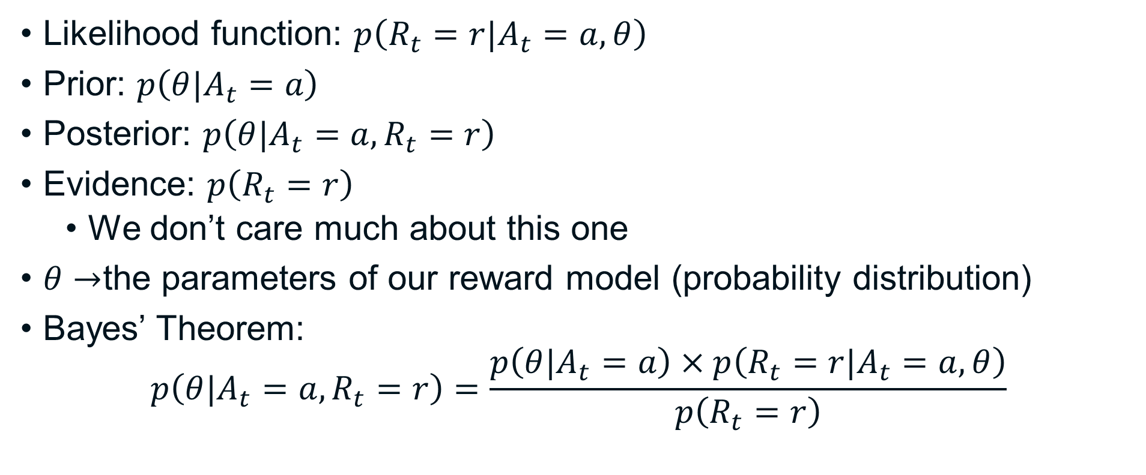
Some statistics
Likelihood function: $p\left(R_{t}=r|A_{t}=a,θ\right)$
Prior: $p\left(θ|A_{t}=a\right)$
Posterior: $p\left(θ|A_{t}=a,R_{t}=r\right)$
Evidence: $p\left(R_{t}=r\right)$
We don’t care much about this one
$θ→$the parameters of our reward model (probability distribution)
Bayes’ Theorem:
$$p\left(θ|A_{t}=a,R_{t}=r\right)=\frac{p\left(θ|A_{t}=a\right)×p\left(R_{t}=r|A_{t}=a,θ\right)}{p\left(R_{t}=r\right)}$$

Slide 19
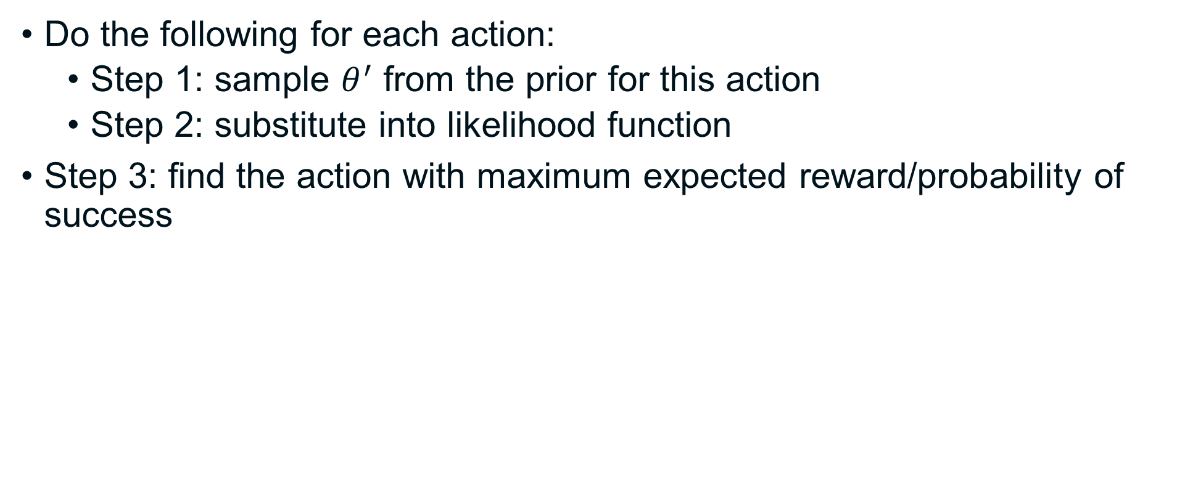
Using statistics
Do the following for each action:
Step 1: sample $θ^{′}$ from the prior for this action
Step 2: substitute into likelihood function
Step 3: find the action with maximum expected reward/probability of success

Slide 20
Some likelihood functions
Bernoulli distribution:
Reward is 0 (failure) or 1 (success)
Uses: clinical trials (1=cured, 0=), advertising (1=click through)
Gaussian distribution:
Reward is continuous
Uses: maximize recovery, profit in mining

Slide 21
Conjugate prior distributions
Analytical solutions for the posterior distribution
Definition: a prior distribution such that both the prior and the posterior belong to the same family of distributions
Bernoulli likelihood: Gamma distribution
Gaussian likelihood: normal-gamma, or normal-inverse gamma distribution
Wikipedia list of conjugate priors: https://en.wikipedia.org/wiki/Conjugate_prior

Slide 22
Tabular solution example

Slide 23
The problem
Maximise throughput of a mill at a mine
Actions:
Four combinations of rotational speed and mill weight
Call them A1, A2, A3, A4
Simplified vs. real life
Unknown mean throughput and variance

Slide 24
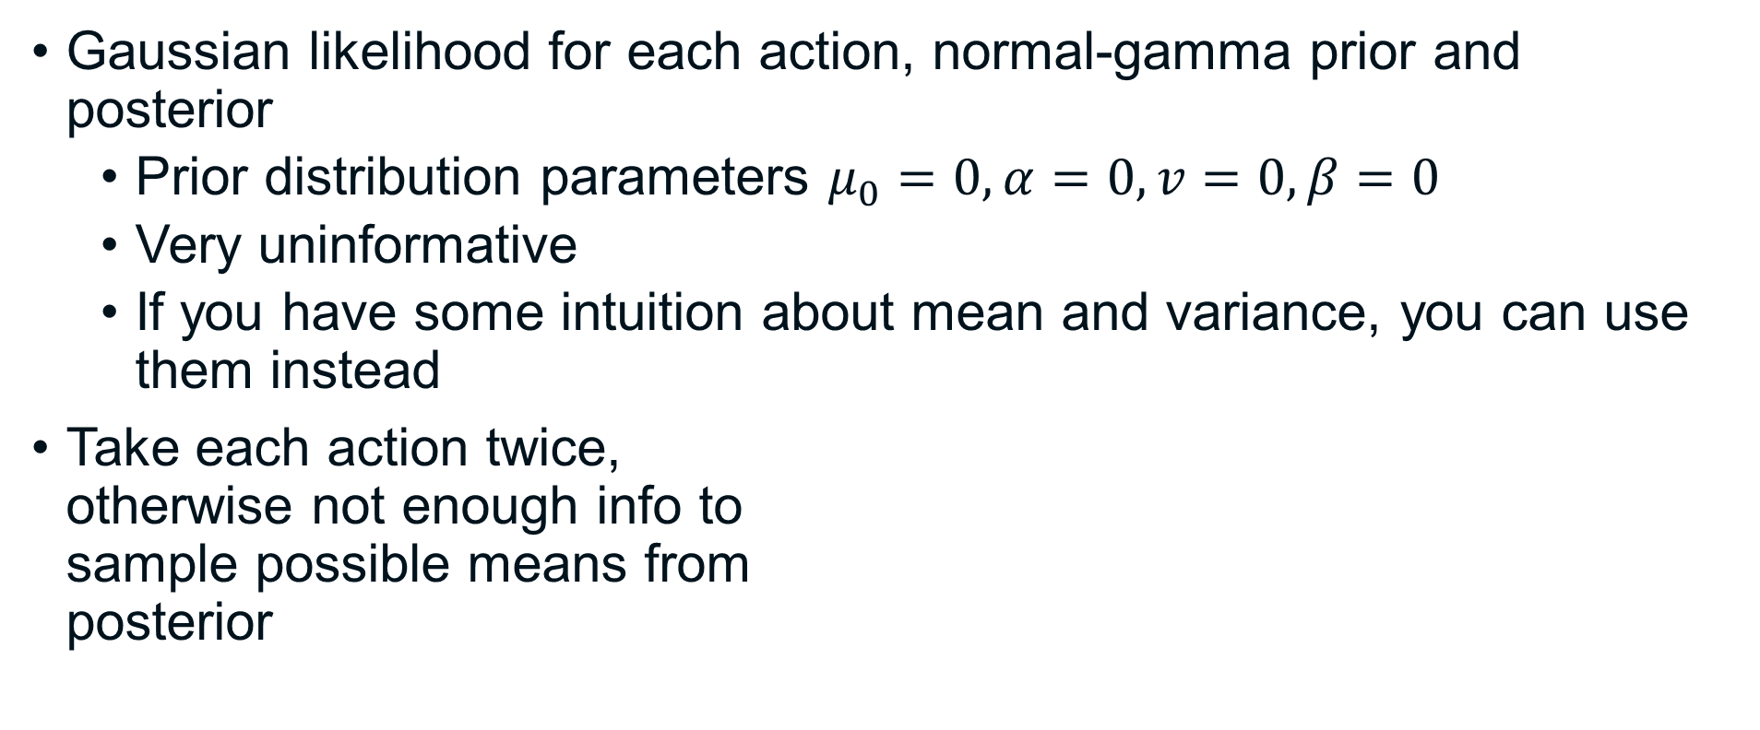
Initial state
Gaussian likelihood for each action, normal-gamma prior and posterior
Prior distribution parameters $μ_{0}=0,α=0,v=0,β=0$
Very uninformative
If you have some intuition about mean and variance, you can use them instead
Take each action twice, otherwise not enough info to sample possible means from posterior
A2
A4
Weight (t)
A1
A3
Speed (RPM)

Slide 25
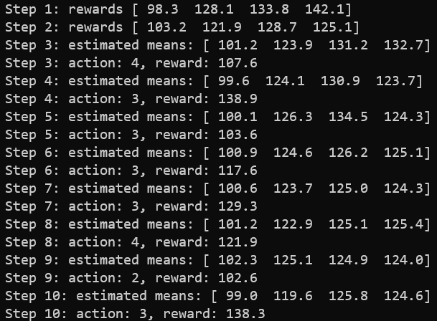
Thompson Sampling demo output

Slide 26
How does this help in real life?
Maximising energy efficiency and/or throughput is a big deal
Maximise throughput & reduce energy per ton of ore
Minimise energy & achieve target throughput
Keep particle size within acceptable range
Milling is power hungry (about 45% of mine costs globally)
Boosting throughput @ similar energy use = $$$

Slide 27
Continuous action spaces
The continuum-armed or infinite-armed bandit

Slide 28
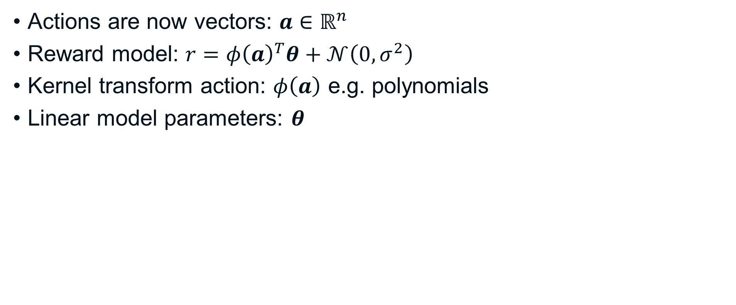
The linear stochastic bandit
Actions are now vectors: $a∈ℝ^{n}$
Reward model: $r={φ\left(a\right)}^{T}θ+𝒩\left(0,σ^{2}\right)$
Kernel transform action: $φ\left(a\right)$ e.g. polynomials
Linear model parameters: $θ$

Slide 29
Increasing Efficiency
Increasing speed changes throughput and power vs. volumetric filling relationship
Simulation environment uses these curves
Revenue: throughput x value of gold per ton of ore
Cost: Eskom tariff schedule, including peak, off-peak and standard rates.
Van der Westhuizen, A., Powell, M.S., 2006. Milling Curves as a Tool for Characterising SAG Mill Performance, in: Proceedings of the SAG Conference, 2006, Vancouver, B.C., Canada.

Slide 30
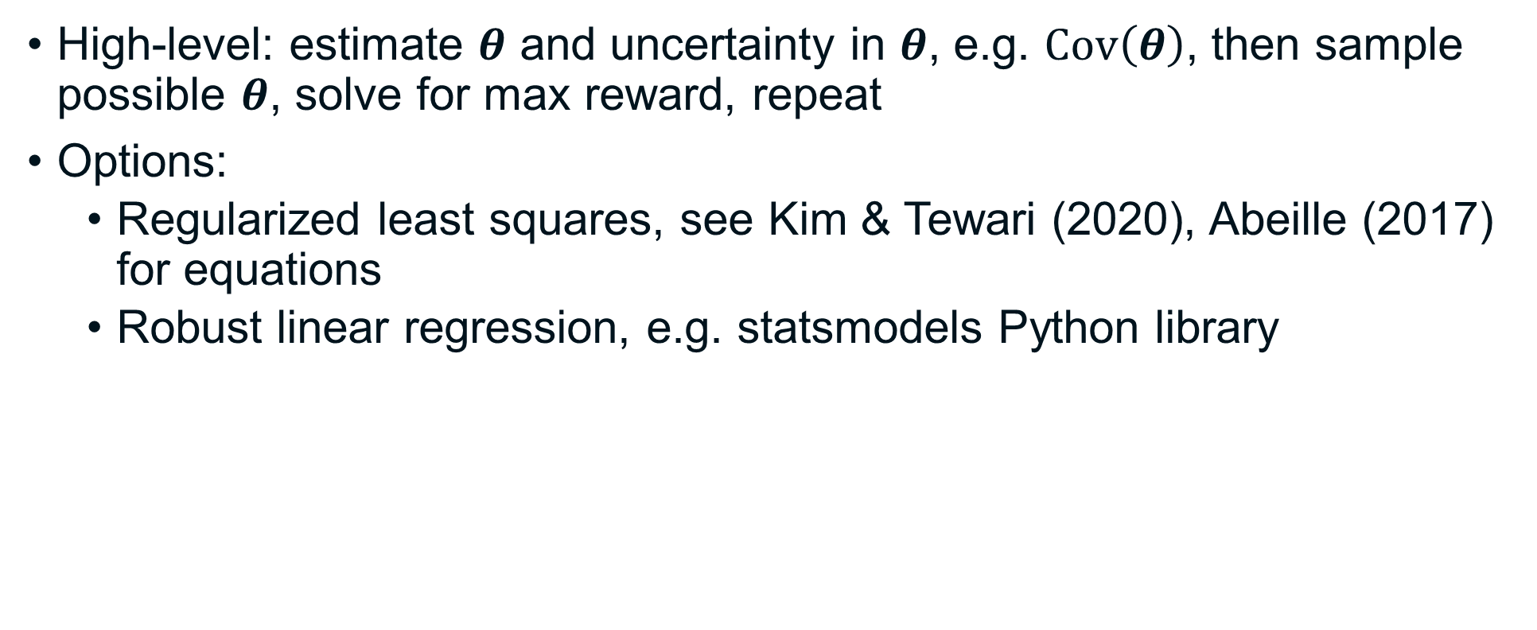
Thompson Sampling for continuous actions
High-level: estimate $θ$ and uncertainty in $θ$, e.g. $\text{Cov}\left(θ\right)$, then sample possible $θ$, solve for max reward, repeat
Options:
Regularized least squares, see Kim & Tewari (2020), Abeille (2017) for equations
Robust linear regression, e.g. statsmodels Python library

Slide 31
Other bandit algorithms
Thompson Sampling isn’t your only option

Slide 32
Other bandit algorithms
Upper Confidence Bound (UCB) sampling:
Optimism in the face of uncertainty
Heuristic confidence bound estimate for reward
Take action with highest reward (mean + confidence bound)
Discrete and continuum-armed versions
Discounted UCB and Thompson Sampling: changing environments
Also sliding window versions for continuum-armed bandits
Bayesian optimisation
Exp3/4

Slide 33
Real-world Applications

Slide 34
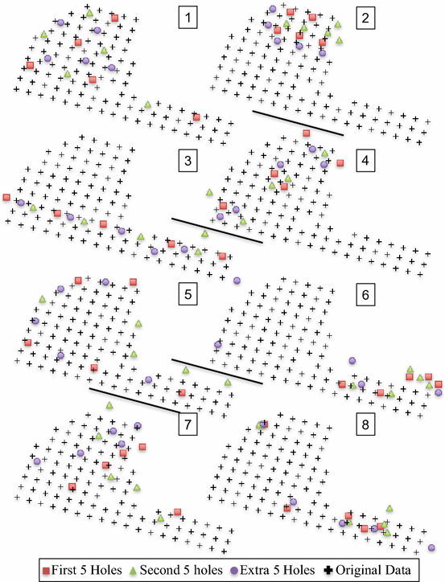
Planning drilling during additional exploration
Dirkx & Dimitrakopoulos, 2018. McGill University. doi:10.1007/s11004-017-9695-9
Choose between several patterns for drilling
Each pattern gives new information about the ore body
Block model – info gain == no. of blocks that changed classification
All done in simulation
Repeat simulation several times – assess risk/variability when following “best” pattern

Slide 35
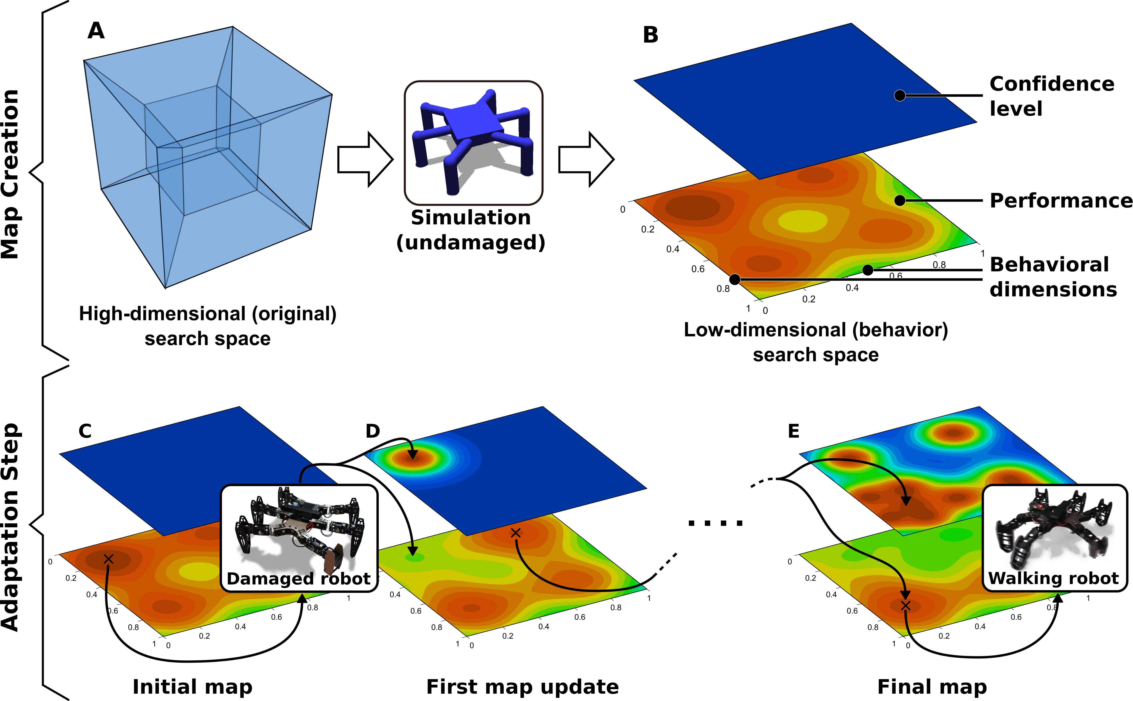
Fault-tolerant robots
Cully, A., Clune, J., Tarapore, D., Mouret, J.-B., 2015. Robots that can adapt like animals. Nature 521, 503–507. doi:10.1038/nature14422. ArXiv:1407.3501
Train ~13k policies, different motion ranges
6D map: policy to expected performance
Bayesian optimisation to search + update this map (a fancy non-linear bandit ☺)
https://youtu.be/WRsxoVB8Yng?t=28077

Slide 36
Dose finding in clinical trials
Aziz, M., Kaufmann, E., Riviere, M.-K., 2021. On Multi-Armed Bandit Designs for Dose-Finding Clinical Trials. Journal of Machine Learning Research 22, 1–38.
Bernoulli bandit: each dose either has a harmful side-effect or no side-effect. Find the highest dose with acceptable probability of side-effects (e.g. cancer treatment)
Variation of Thompson Sampling – select action (dose) with toxicity probability closest to target threshold
Did better than traditional dose-finding methods

Slide 37



Get in touch if you have any questions
Contact details
Williams@mintek.co.za
https://www.linkedin.com/in/williamshipman/

Slide 38
Useful references
Sutton, R.S., Barto, A.G., 2018. Reinforcement learning: an introduction, Second edition. ed, Adaptive computation and machine learning series. The MIT Press, Cambridge, Massachusetts.
Bilgin, E., 2020. Mastering Reinforcement Learning with Python: Build next-generation, self-learning models using reinforcement learning techniques and best practices. Packt Publishing Ltd.
Lattimore, T., Szepesvári, C., 2020. Bandit Algorithms, Online Edition. ed. Cambridge University Press. doi:10.1017/9781108571401
Ghavamzadeh, M., Mannor, S., Pineau, J., Tamar, A., 2015. Bayesian Reinforcement Learning: A Survey. FNT in Machine Learning 8, 359–483. doi:10.1561/2200000049, ArXiv:1609.04436

Slide 39
Useful references
Kim, B., Tewari, A., 2020. Randomized Exploration for Non-Stationary Stochastic Linear Bandits, in: Proceedings of the 36th Conference on Uncertainty in Artificial Intelligence (UAI), Proceedings of Machine Learning Research. PMLR, p. 10.
Abeille, M., 2017. Exploration-Exploitation with Thompson Sampling in Linear Systems. Université de Lille.
Burtini, G., Loeppky, J., Lawrence, R., 2015. A Survey of Online Experiment Design with the Stochastic Multi-Armed Bandit. arXiv:1510.00757 [cs, stat].
Shipman, W.J., 2021. Optimizing Milling Operations using Continuum-Armed Bandits with Multiple Reward Components and Constraints, SACAIR2021

Slide 40
Thank You
www.mintek.co.za

